Slide 1

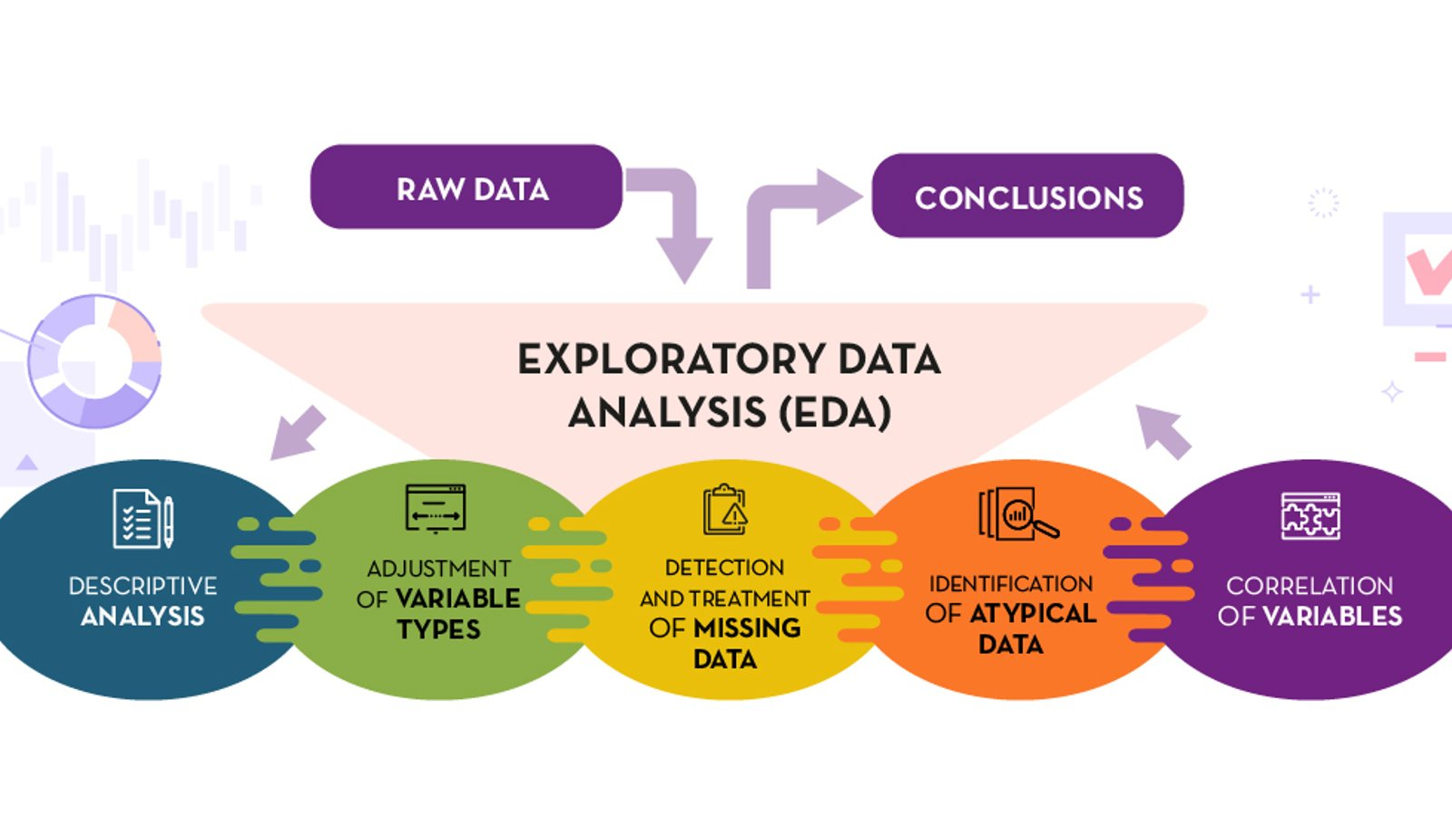




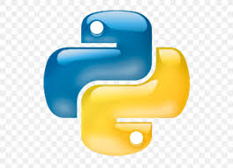


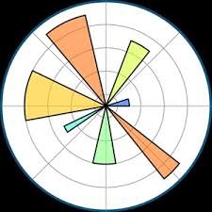
Architecture
Data Collection
Raw data
First it take raw data perform EDA and make it clean. Then the clean data send again back to database.
For python operati
Load Data in DataBase
Here we use Postgresql
Clean data
Secondary data
Visualization Tools
For accessing good insights
Decision Making Based on the Insights
Data preprocessing using numpy and pandas
Result

